Slide 1
Escape Room Profiling & Saturation
By Keith Jones

Slide 2
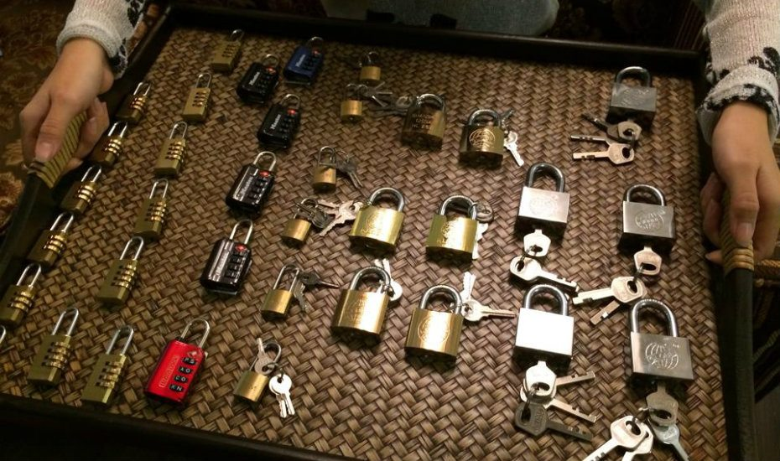
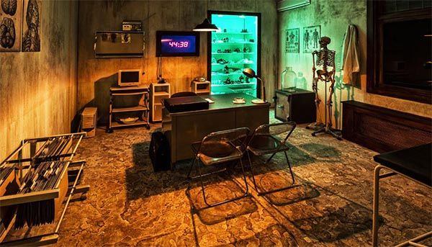
What is an Escape Room?
4 – 8 people put into a themed room filled with locks and puzzles
Need to solve the puzzles somewhat sequentially
Solve them all within a certain time (usually 60 minutes) to ‘escape the room’

Slide 3
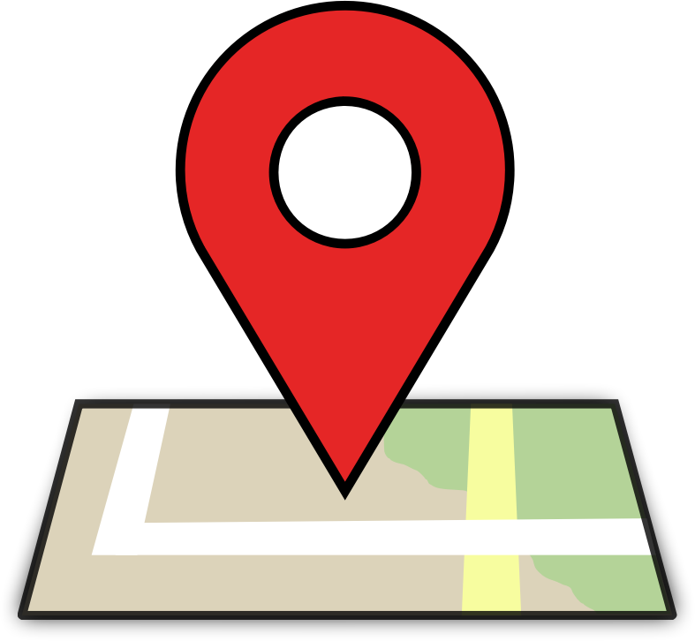
So you want to start an escape room?
Relatively new industry
Still growing
Capital required to start one can be rather low, especially if you create your own puzzles
But as they become more popular and more frequent, where do you put new escape rooms?

Slide 4
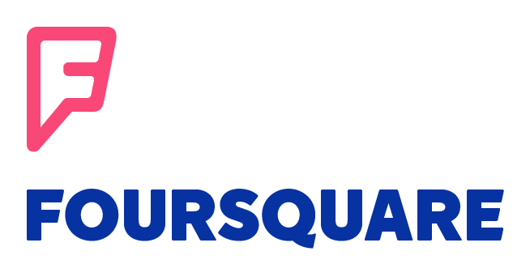


We’ve got an analysis for that!
Data from several different sources:
Locational data from Foursquare’s database
Zip Code information from www.BestPlaces.net
Population Density data by zip code from the Splitwise Blog
https://blog.splitwise.com/2014/01/06/free-us-population-density-and-unemployment-rate-by-zip-code/

Slide 5
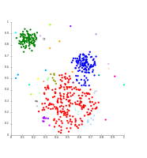
Only the Data You Need!
Data on existing escape rooms in the area pulled from Foursquare
Zip codes filtered for appropriate population density
Venue information gathered for each remaining zip code in the area
Neighborhood profiles created using machine learning
K-Means Clustering
Results for Phoenix/Mesa, Salt Lake City, and Houston

Slide 6
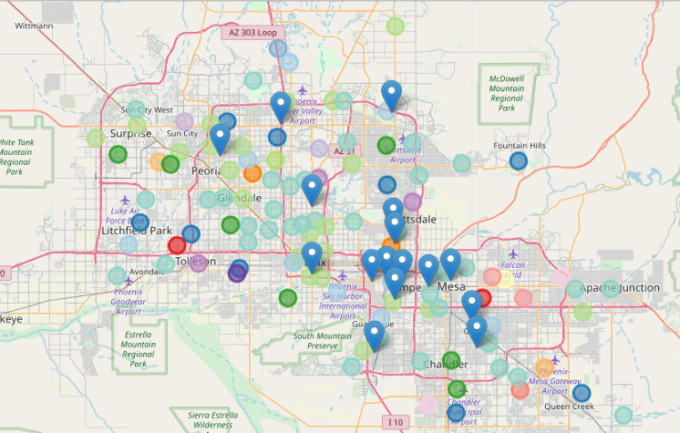

Phoenix Arizona

Slide 7


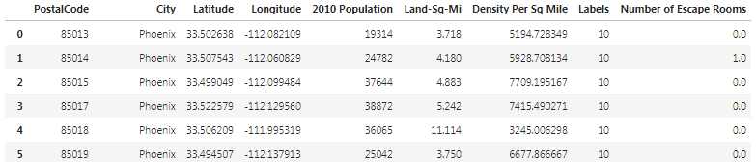
Phoenix/Mesa Metropolitan Area
Most successful escape rooms:
Escape the Room
Riddle Escape Room
Out of 155 zip codes, 41 met the same neighborhood profile as these two rooms (see below)
85013, 85014, 85015, 85017, 85018, 85019, 85021, 85023, 85031, 85032, 85035, 85048, 85050, 85051, 85086, 85120, 85140, 85143, 85201, 85203, 85208, 85210, 85224, 85233, 85251, 85257, 85258, 85259, 85260, 85284, 85295, 85296, 85298, 85302, 85303, 85305, 85307, 85310, 85323, 85338, and 85375

Slide 8
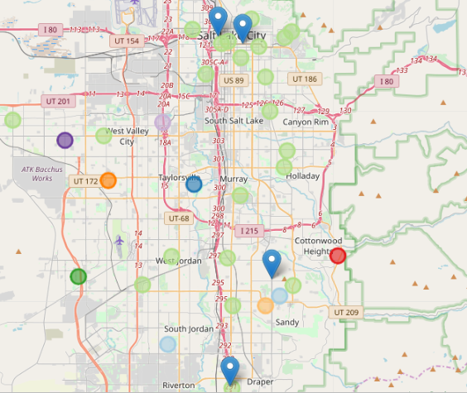

Salt Lake City, Utah

Slide 9


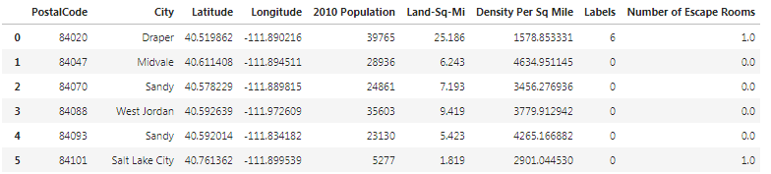
Salt Lake City Metropolitan Area
Most successful escape rooms:
Alcatraz Escape Games
Mystery Escape Room
Out of 46 zip codes, 20 met the same neighborhood profile as these two rooms (see below)
84020, 84047, 84070, 84088, 84093, 84101, 84102, 84103, 84104, 84105, 84106, 84107, 84111, 84112, 84113, 84115, 84117, 84119, 84120, and 84124

Slide 10
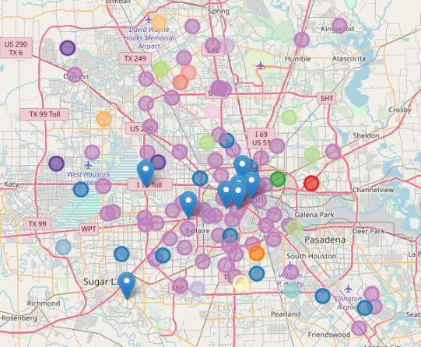

Houston Texas

Slide 11
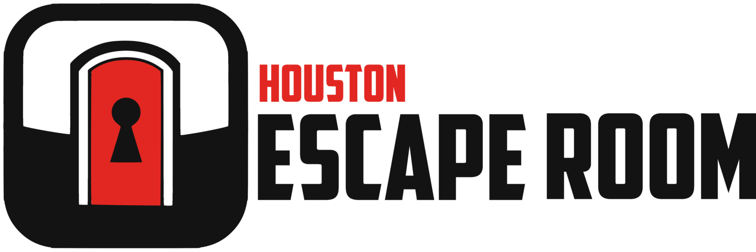
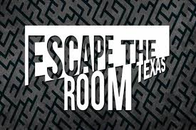
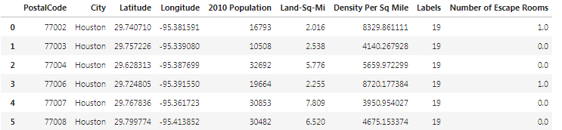
Houston Metropolitan Area
Most successful escape rooms:
Houston Escape Room
Escape the Room Texas
Out of 101 zip codes, 65 met the same neighborhood profile as these two rooms (see below)
77002, 77003, 77004, 77006, 77007, 77008, 77009, 77010, 77011, 77012, 77016, 77018, 77019, 77020, 77021, 77023, 77024, 77025, 77026, 77027, 77031, 77032, 77035, 77036, 77037, 77040, 77041, 77042, 77044, 77045, 77046, 77051, 77054, 77056, 77057, 77058, 77059, 77060, 77061, 77063, 77064, 77067, 77068, 77070, 77072, 77074, 77077, 77079, 77081, 77082, 77084, 77085, 77086, 77087, 77088, 77090, 77092, 77093, 77096, 77098, 77339, 77345, 77388, 77429, and 77598

Slide 12

Before You Go . . .
Some things to keep in mind about these location recommendations:
Results are not completely perfect—K-Means Clustering can shift with different iterations
Analysis does not take into account ‘one-shot’ locations that only show up in one zip code and not others (for example, universities, hospitals, prisons, airports, etc.]
In the clustering, some clusters had large amounts of the zip codes, despite constraining based on population density
No location can compensate for a poor business plan or lack of a good experience for patrons

Slide 13
In Conclusion
You now have 3 lists of data for 3 different cities, full of recommendations of zip codes that would be strong candidates to put a future escape room
Remember the cautions on the previous slide!
Potential recommendations for future analysis:
Using Yelp data
Run clustering on full data set once, then run clustering again on just the zip codes returned in the 1 or 2 largest clusters

